Slide 1
Monday, January 7, 2013
Agenda
No TISK or MM
Lesson 7-1: Proportions
Homework: Chapter 7 Packet 1 §7-1problems
Please be ready to start taking notes after attendance is taken.

Slide 2

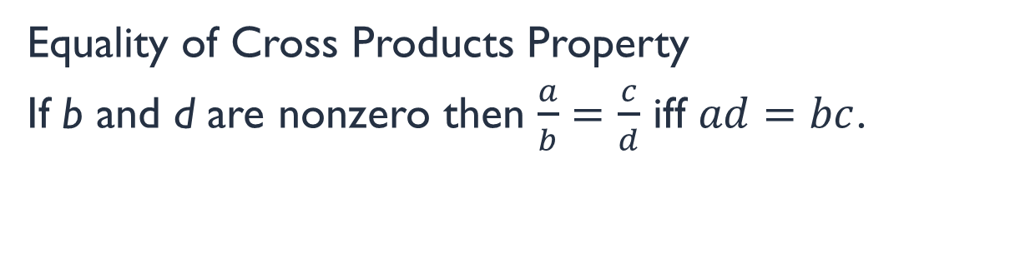


§7-1 Using Proportions
Equality of Cross Products Property
If b and d are nonzero then $\frac{a}{b}=\frac{c}{d}$ iff $ad=bc$.
I remembered this property as “Going Fishing”:
$$=$$
$$\frac{a}{b}=\frac{c}{d}$$
$$×$$

Slide 3




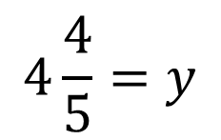





Example 1. Solve the proportion.
$$\frac{3}{y}=\frac{5}{8}$$
$$\frac{x}{3}=\frac{12}{x}$$
$$=$$
$$=$$
$$8∙3=y∙5$$
$$x∙x=3∙12$$
$$24=5y$$
$$x^{2}=36$$
$$4\frac{4}{5}=y$$
$$x=±6$$

Slide 4























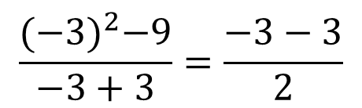
Only one minor issue comes up…
Sometimes you get what are called extraneous solutions.
These are solutions that don’t actually work.
Example 2. Solve the proportion:
$$\frac{y^{2}−9}{y+3}=\frac{y−3}{2}$$
Now check each solution in the original proportion…
$$=$$
$$\frac{3^{2}−9}{3+3}=\frac{3−3}{2}$$
$$2∙(y^{2}−9)$$
$$=$$
$$(y+3)(y−3)$$
$$\frac{{(−3)}^{2}−9}{−3+3}=\frac{−3−3}{2}$$
$$2y^{2}−18=y^{2}−9$$
$$−y^{2}$$
$$−y^{2}$$
$$\frac{9−9}{6}=\frac{0}{2}$$
$$\frac{9−9}{0}=\frac{−6}{2}$$
$$y^{2}−18=−9$$
$$+18$$
$$+18$$
$$\frac{0}{6}=\frac{0}{2}$$
$$y^{2}=9$$
$$y=3$$
$$\frac{0}{0}=−3$$
$$0=0$$
$$y=±3$$

Slide 5













When does this happen?
When a denominator simplifies to 0…
Try it out…
Example 3. Solve the proportion:
$$−\frac{3}{d}=\frac{d−3}{2d}$$
$$=$$
$$d≠0$$
$$2d\left(−3\right)$$
$$=$$
$$d(d−3)$$
$$d=−3$$
$$−6d=d^{2}−3d$$
$$+6d$$
$$+6d$$
$$0=d^{2}+3d$$
$$0=d(d+3)$$
$$0=d or d=−3$$

Slide 6
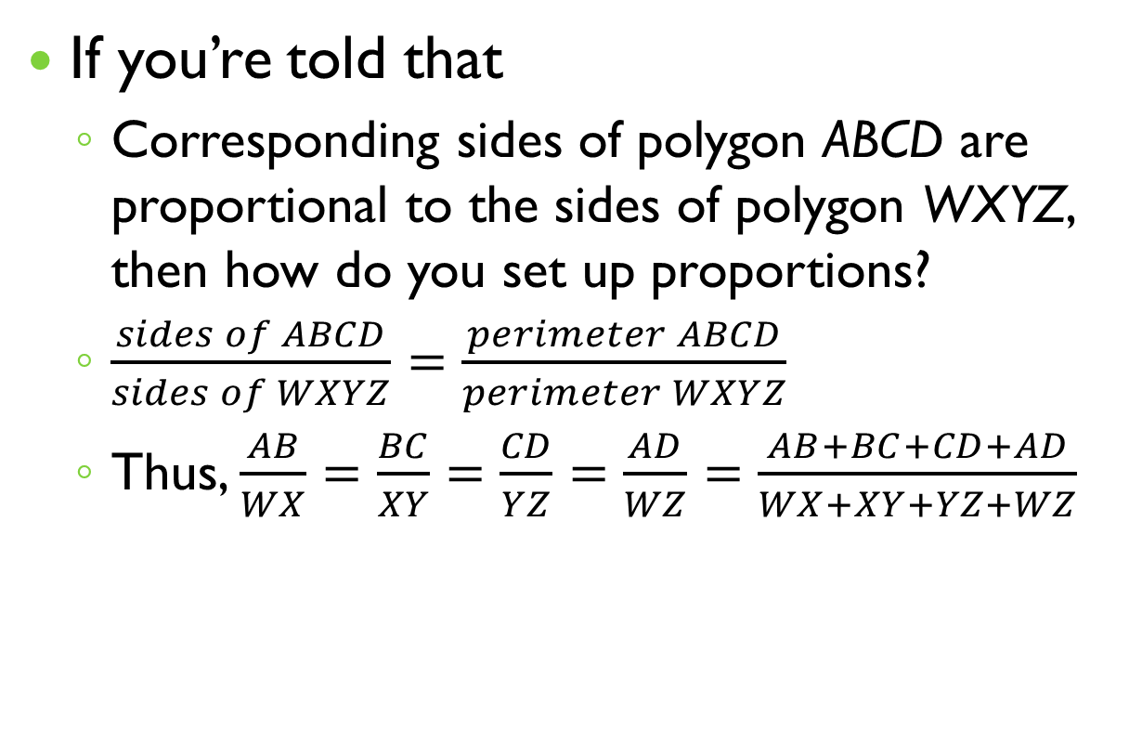
Corresponding Sides are Proportional
If you’re told that
  Corresponding sides of polygon ABCD are proportional to the sides of polygon WXYZ, then how do you set up proportions?
  $\frac{sides of ABCD}{sides of WXYZ}=\frac{perimeter ABCD}{perimeter WXYZ}$
  Thus, $\frac{AB}{WX}=\frac{BC}{XY}=\frac{CD}{YZ}=\frac{AD}{WZ}=\frac{AB+BC+CD+AD}{WX+XY+YZ+WZ}$

Slide 7
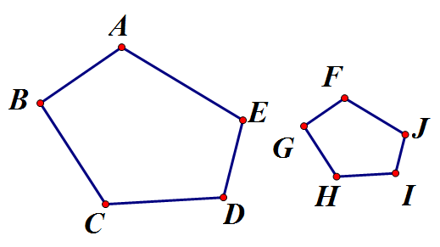
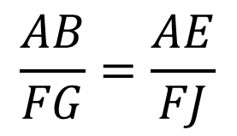



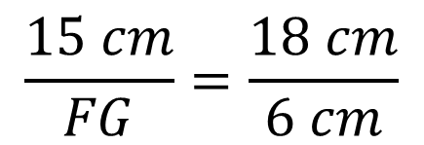
Example.
Corresponding sides of polygon ABCDE are proportional to the sides of polygon FGHIJ. Find FG.
$$\frac{AB}{FG}=\frac{AE}{FJ}$$
15 cm
18 cm
6cm
17 cm
12 cm
4 cm
$$\frac{15 cm}{FG}=\frac{18 cm}{6 cm}$$
15 cm
$$\frac{15 cm}{FG}=\frac{3}{1}$$
$$15 cm=3FG$$
$$5 cm=FG$$

